Slide 1
Software Architecture & Design (cpsc-61200) Sound & Recording Check
Cohost Volunteer(s)?
Onsite participants:
Sit in a good spot near the “speaker phone” if possible
Optionally sign into Join.me… but make sure that your microphone and speakers are muted/off
Remote participants:
Log into Join.me
For Screen Sharing utilize your computer
For conference call audio utilize your computer speakers and microphone OR dial into the session with your mobile phone
Start recording and then stop recording after a few seconds
Check recording sound when video is released by Join.me

Slide 2

Software Architecture & Design Discussion, Lecture, & Lab Eric Pogue
Agenda for Monday, October 21st from 6 to 10pm CST:
Welcome!
Friendly Conversation Topic
Course Overview
Introductions*
Pre-work & Syllabus Discussion
Course Schedule
Sprint Planning
Assignment
Metaphors, Analogies, and Models
Lab starting no later than 7:20pm
Discussion & Questions welcome at any time… please be present with no phones or email during our time together

Slide 3
Welcome!
This is:
Software Architecture & Design (cpsc-61200)
M 6-10pm CST
AS 104A
And I am:
Eric Pogue
Welcome to those who:
Were able to attend in person… Thank you!
Remote participants… Welcome!
Will be watching the session recording later
Review Announcements that were made via Blackboard

Slide 4

Today’s Friendly Conversation topic

Slide 5
Today’s Friendly Conversation topic

Slide 6
Course Overview
Software Architecture & Design (cpsc-61200)
Part of our Master of Science in Computer Science program [link]
This is our first time offering the course
Your feedback is greatly appreciated
Special Thanks to Dr. Safwan Omari for developing the curriculum
Clarification: Two courses (one online and one onsite) were combined into a single course that will be offering both online and onsite content.
Notes:
Eric’s Biases
Agile over Iterative OVER Waterfall
Our textbook is very Waterfall-ish
Initially I thought these differences would be a challenge; however, after talking with Safwan we agreed that you a graduated students should be presented with alternate ideas
Ubuntu Linux
Python

Slide 7
Introductions*
Full and Preferred Name:
Eric Pogue
Eric, Mr. Pogue, or Professor
Family, Home, College background:
Married with five children, relocated from Davenport, IA to Chicago area a couple years ago
Undergraduate in CS and Masters in Business… teaching online/evening for many years
Programming experience:
Decades in the industry as a developer, architect, project manager, division manager, and vice president of various software development organizations
Part of many teams that have delivered products to ten’s of millions of customers globally
Parsons Technology, Intuit, The Learning Company, Jasc Software, and John Deere
… and most recently working on a startup product in the Architecture field with my oldest son

Slide 8








Slide 9
Welcome & Introductions
Likely programming environment
Personal Laptop, Windows 10 (moving to MacOS), Chrome browser, and Visual Studio Code text editor… looks like I will be learning some Ubuntu Linux over the next few weeks
Hobbies:
Wilderness Canoeing & Camping (Quetico) and Triathlons
Top two or three things that you would like to get out of this class
help each of you be successful in this class
explore software development Architecture and Design processes and techniques together and motivate you to look deeper
and for us to find a little enjoyment and fun along the way*
… oh yes, and it would be wonderful if I could help you build something that made you proud during the semester
Fun Fact:
At one point I had the very dubious “honor” or being the most traveled John Deere employee to India with 40+ trips over a 5-6 year period while setting up the 400+ person John Deere Technology Center – India application development organization.

Slide 10
Pre-work & Syllabus Discussion

Slide 12

Scrum Process & Roles – Sprint Planning
By Dr ian mitchell - Own work, CC BY-SA 4.0, Link

Slide 13
Assignment for Next Class
All sprint 1 / week 1 activities & assignments are due Sunday night*
Pre-work assignments for Sprint 2 will be made available by Monday morning in preparation for our Monday 6pm session next week

Slide 14
Wrap-up and Final Questions/Comments

Slide 15
Break & End of First Recording

Slide 16
Lab
As A Group:
Complete DB*
Complete DB1
Work on Lab 1
Team Report Out Guidelines
Scrum Master will stand up, give your name, your team name, and briefly answer the following questions:
What did you accomplish since the last meeting? And what will you be working on until the next meeting?
Is the team committed to completing assignments? All/Most/Some
What is getting in your way or keeping you from completing the assignments?

Slide 17
DB* Instructions
As A Group:
Start Recording
Review DB*
Answer Blackboard Questions Plus
What development processes have you worked in (Waterfall, Iterative, Agile)? Pros/Cons in your experience?
How much experience do you have with Linux and Python
Actively ask (easy) follow-up questions
Past the link to the DB* video in the DB* response area and receive full credit

Slide 18
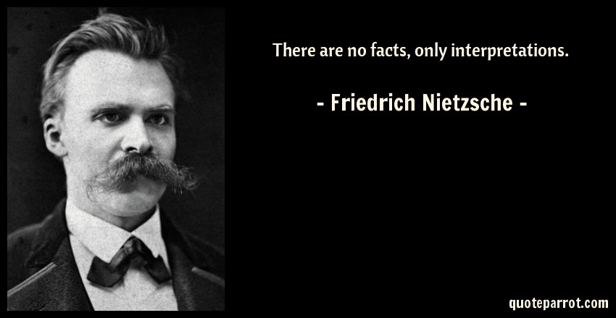
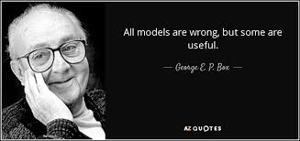
DB1 Instructions
As A Group:
Start Recording
Consider: Metaphors, Analogies, and Models
Review DB1
Actively participate in DB1 Discussion
Actively ask (easy) follow-up questions
Past the link to the DB1 video in your the DB1 response area and receive full credit

Slide 19
DB1 Instructions
As A Group:
Start Recording
Consider: Metaphors, Analogies, and Models
Review DB1
Actively participate in DB1 Discussion
Actively ask (easy) follow-up questions
Past the link to the DB1 video in your the DB1 response area and receive full credit

Slide 20
Work on Lab 1
As A Group:
Start Recording
Record only as needed and is valuable
Notes:
I was going through the first week's material, by the way (and thanks for sharing the textbook offer!), and I found in Lab 1 there could be a step between 3 & 4 to get the pip installer:
$ sudo apt install python-pip

Slide 21
End of Session & Recordings

Slide 22
Today’s “Friendly Conversation” topic
Agile Manifesto
“We are uncovering better ways of developing software by doing it and helping others do it. Through this work we have come to value:
Individuals and interactions over processes and tools
Working software over comprehensive documentation
Customer collaboration over contract negotiation
Responding to change over following a plan
That is, while there is value in the items on the right, we value the items on the left more.”
Notes:
This was kind of “hippy-ish” and egalitarian in its day… quite controversial in its day
“Everyone is a team member and is responsible for the work getting done”… we don’t need no titles or positions… self-organizing… we will make our own commitments… transparency (let’s share the information)… flexible/organic teams, organic architecture (minimal documentation/standards)… no contracts (let’s talk it over)
The flip side:
We will actively and voluntarily play important roles on our team
The rules (rituals) that we do have… we WILL follow
We will create, demo, and release working software/products
We will utilize practical processes, tools, documentation, and planning
When we make commitments, we will live up to those commitments… as a team (“No winners on a losing team, and no losers on a winning team”)
We will be responsive and continuously improve (Retrospectives)
We will be transparent with how WE work and share our information

